Slide 1
St Bons SIP 2023-24
Term 4 update to parents and carers

Slide 2
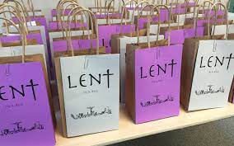
Priority 1: To increase pupils engagement and application of knowledge in RE through an oracy based approach.
All prayer and liturgy links to either the RE unit or the whole school theme.
A focus for terms 4-6 is pupil led prayer and liturgy. Chaplains will be planning and leading Lent reflections using Lent Bags every Monday throughout Lent.
Chaplaincy will be evaluating HT prayer and liturgy throughout term 4.

Slide 3
Priority 2: To introduce an oracy based approach to support high quality outcomes across the curriculum.
An extended staff meeting in term 3 allowed teachers to focus on the next strand of oracy: presentational talk.

Slide 4
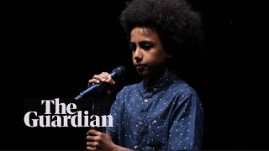
Poetry will be a focus for all KS1 & KS2 pupils in term 4. In class they will compose their own poems based around the topic of ‘I am’ or ‘We are’.
Pupils will be taught how to perform their poems using a range of strategies.
Pupils in KS1 and KS2 will take part in a poetry slam where chosen poems will be performanced at the Easter festival.

Slide 5
Priority 3: Foundation subject leaders to map out knowledge, skills, content and assessment of their subject within the whole school themes with a focus on revisiting prior learning and assessment.
DT is the focus for terms 4-6. DT week takes place in WB: 18th March.
DT curriculum map in place. Staff meeting takes place WB: 26th Feb outlining St Bons approach to DT.
Focus for week is vehicles. Whole school will engage in this topic.
Classes will have a DT floor book to record outcomes.
We will use staff and pupil feedback to inform future DT weeks.

