Slide 1
Parents Reading Workshop 2023

Slide 2
Sharing a book with children.
33
After …
Praise them – be specific.
Ask a general question – what happened in the book?
Ask a specific question about a character or event in the book.
Reading the book …
Child holds and turns pages.
They can point if needed.
Encourage use of pictures, sounds, context to ‘get to unknown words.
Use prompts to help rather than telling them the word.
Encourage phonics if appropriate.
Before …
Look at title and cover
Who are the characters?
What might it be about?
Look through pictures

Slide 3
Prompts to help independence – what to say.
Visual
Meaning
Does it look right?
Get your mouth ready to say the first sound.
Read to the end of the word.
Check it with your eyes.
Look for what you know.
Do we say that?
Does it make sense?
What would make sense?
Does it sound right?
What would sound right?

Slide 4
Things to look out for
Word endings
ing, ed, s
Look, looks, looked, looking
Shop, shops,
shopped, shopping
Cover the ending with
a finger.
Hiding words
today
about
onto
behind
Encourage child to look for what they already know.
Common issues
Was/saw
Of/for
I/It
b/d
Usually visual so prompt with ‘get your mouth ready for the first sound’
Glued together words (Compound words)
Upstairs
Outside
Playground
Everywhere
Can you spot where the two words start and end?

Slide 5
Understanding the text
Beginning
Middle
End
Retrieval questions
What happened to…
Why did……
Where was…….
Tell me about the story………
Characters
Who were they?
What happened to them?
Vocabulary
What does…..mean?
Can you think of another word instead of ‘great’?
Inference
Reading between the lines.
Why do you think….
How was x feeling?
Predicting
What might happen next?
If there was another picture what would
we see?

Slide 6
But I don’t want to read!!!!!!
Read a book that is well known to them – less pressure. It is good to practice reading known books.
Take turns –
Read a page each.
Talk through the pictures instead.
Find another time to read – when they are less tired/hungry/distracted?!

Slide 7
The most important bits……
Listen to your child regularly – at least 4 times a week.
Ask them about the book - check understanding
Help them to see themselves as a reader – read other things around the home/community.
Let them see you reading – take it in turns so they hear what fluent reading sounds like.

Slide 8
Reading in Reception

Slide 9
Levels 2-4

Slide 10
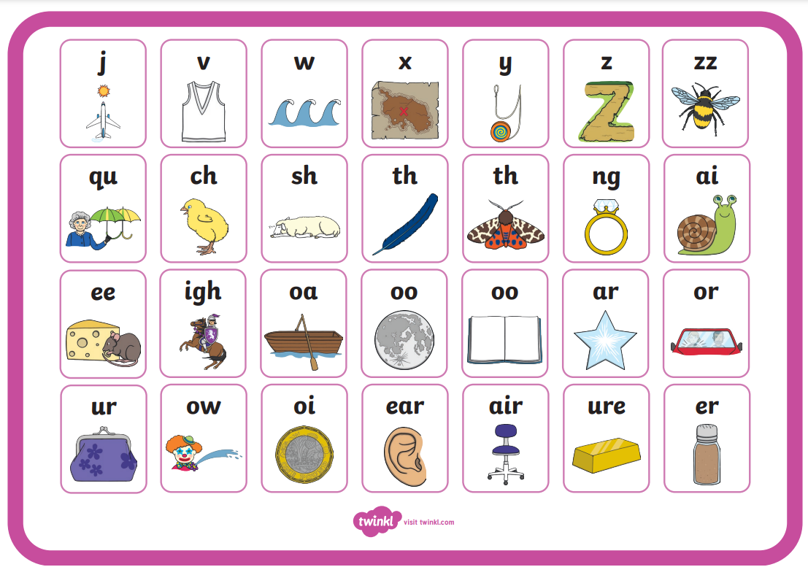
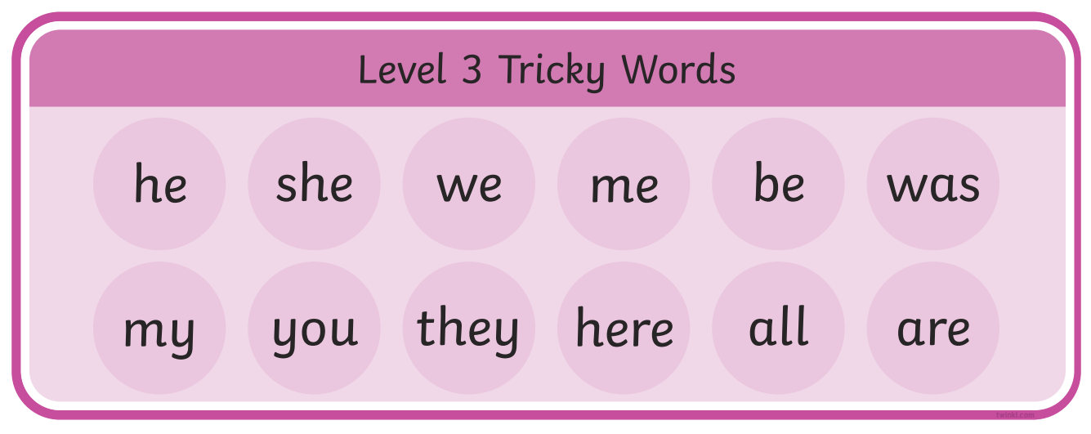
Level 3

Slide 11
Level 4

Slide 12
Phonic definitions
Phoneme — the smallest single identifiable sound
Grapheme- is a symbol (or group of letters) that represents a sound (phoneme).
Digraph- a combination of two letters representing one sound eg sh ch th
Trigraph-a group of three letters representing one sound eg igh, ear, air

Slide 13
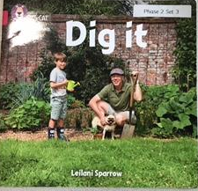
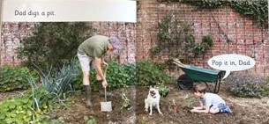
Phonic books and repetitive tricky word books

Slide 14
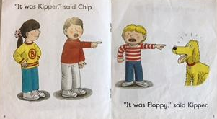

Slide 15
Expectations in Reception
Children will have 2-4 reading books every week. One of these will be a phonics based decodable book.
Children are heard to read at school, once a week, one to one with an adult. We also have daily phonics lessons and lots of reading within the environment.
Please listen to your child read every day if possible.
It is okay to re-read books. This helps children develop their fluency and expression.
Please ensure your child holds the book.
Children should point to the words themselves. Please do not point for them.
Please ask your child questions at the start and the end of the reading time. This is very important as it will develop your child’s comprehension skills.
At the end of the year we aim for children to be on a level 6 / Level 4 books.

Slide 16
Reading in Year 1

Slide 17
Children will leave FS with a range of reading levels, possibly from level 2 or 3 up to a level 10 or above.
Every child is different and every child will learn to read at a different rate and using different strategies.
In Year 1 we use phonics and a range of reading books to help the children.
In June, all Year 1 children complete the Phonics Screening test.
At the end of Year 1 we expect children to reach level 18.

Slide 18
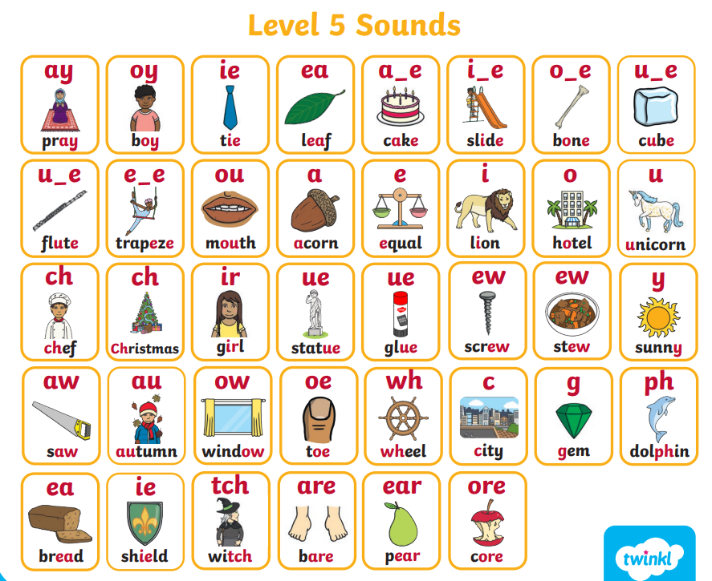
Phonics
In Year 1 we will revisit levels 3 and 4 phonics and teach level 5 phonics and alternative spellings.
Alternative spellings
For example:
‘y’ saying ‘igh’ - fly
‘a’ saying ‘ai’ – baby
‘dge’ saying ‘j’ - bridge

Slide 19
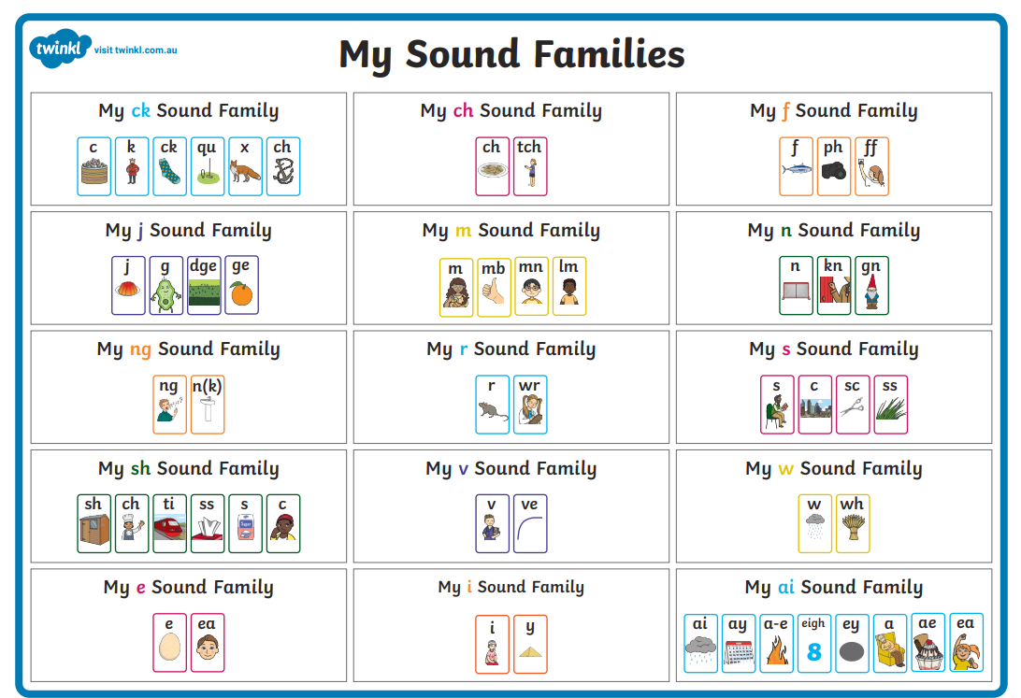
Sound families

Slide 20
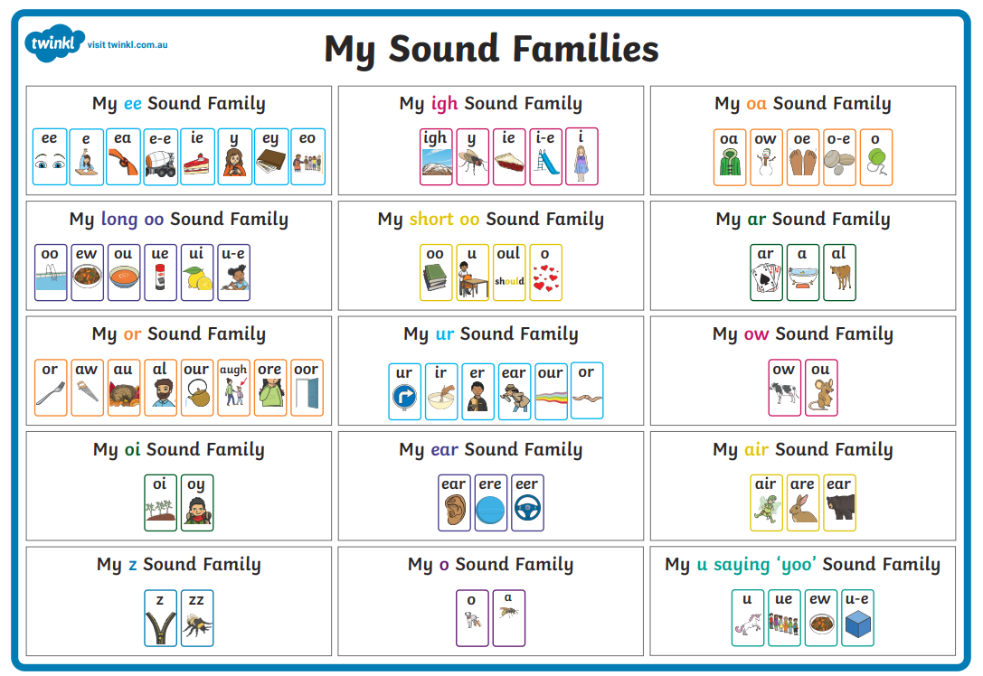

Slide 21
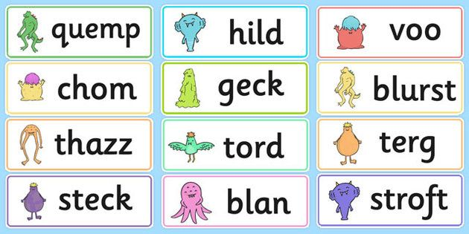
Alien words
We spend a lot of time reading alien words with all our phonic sounds. This is to help
children decode words using their phonic knowledge. We also use sound buttons
and sound bars to show the different single sounds, the digraphs (one sound 2 letters
e.g. ‘sh’ and trigraphs (one sound 3 letters e.g. ‘air’).
blurst

Slide 22
Phonics Screening Check
The Phonics Screening Check is a government test to show how well children can use the phonics skills they've learned up to the end of Year 1. It is purely based on reading individual real and alien words.
It is carried out at school by a known member of staff in a quiet one to one environment. The children have the opportunity to draw sound buttons under the words before they read and decode them.
The test consists of 40 real and alien words and the pass mark is usually 32. Parents are informed of their child’s score in their end of year reports.
The Phonics check is not an indicator of how well your child can read.

Slide 23
Reading in Year 1 – Things to remember
Children will have 4 reading books every week. One of these will be a phonics based decodable book.
Children are heard to read at school, once a week, one to one with an adult. We also have daily phonics lessons and lots of reading within our English lessons. From term 3 we also have weekly guided reading comprehension lessons.
Please listen to your child read every day if possible.
It is okay to re-read books. This helps children develop their fluency and expression.
Please ensure your child holds the book.
Children should point to the words themselves. Please do not point for them. From level 6, children do not need to point but it may help some children to focus.
Please ask your child questions at the start and the end of the reading time. This is very important as it will develop your child’s comprehension skills.

Slide 24
Reading in year 2

Slide 25
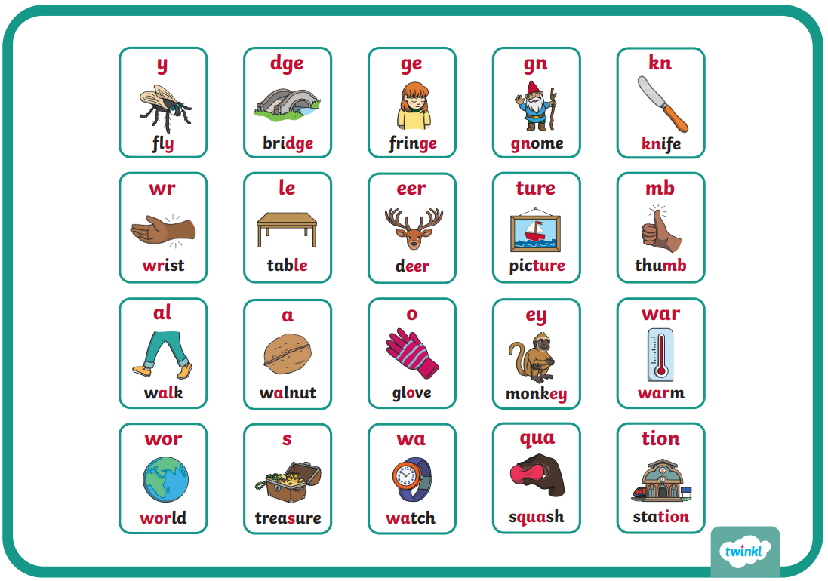
Level 6

Slide 26
Reading Expectations
We aim for children to reach at least level 24 by the end of year 2, this stands them in good stead for meeting the expectations of the comprehension papers and prepares them for KS2.
We would like for children to read as often as possible at home (at least 4 times per week) 10-15 minutes is great, it doesn’t have to be a long reading session.
Reading to your children, or encouraging their own free reading supports ‘reading for pleasure’ which in turn impacts on their vocabulary and enhances their writing.

Slide 27
Comprehension

Slide 28
Assessment
Paper 2
Paper 1

Slide 29
Questions

