Slide 1
KS1 parent workshop- Maths at St Bons

Slide 2
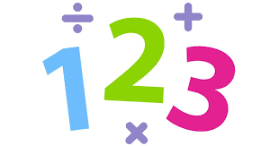
Aims of the workshop
To understand how we teach maths at St Bons
To have an understanding of the National Curriculum requirements
To become familiar with the basic methods we use to teach maths at St Bons
To be aware of resources that can be used to support your child(ren)

Slide 3
Maths at St Bons
All children will engage in a daily maths lesson
Teacher led immediate intervention for children with misconceptions within a lesson
Additional support outside of maths lesson for pupils requiring additional support- all abilities

Slide 4
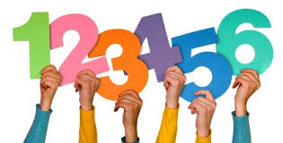
What does my child need to know?
The National Curriculum, revised in 2014, has three over arching aims that when combined increase children's mathematical proficiency:
Fluency
Reasoning
Problem solving

Slide 5
'The national curriculum for mathematics aims to ensure that all pupils.....become fluent......reason mathematically..... and can solve problems.'

Slide 6
Fluency
The ability to recall and apply knowledge efficiently, accurately and flexibly.
Children need to understand why they are doing what they are doing, and know when it is appropriate to use different methods.
Let’s have a go…

Slide 7
Reasoning
The ability to make use of all mathematical skills.
Reasoning is used when children decide what they should do to solve a mathematical question.
Let’s have a go…

Slide 8
Problem solving
The ability to seek solutions, explore patterns and formulate mathematical opinions.
We want our children to confidently manipulate their maths knowledge to develop a curiosity and love for maths.
Let’s have a go…

Slide 9
Reception Maths development

Slide 10
Multiplication policy

Slide 11
Addition policy

Slide 12
Subtraction policy

Slide 13
Division policy

Slide 14
Fractions policy

Slide 15
Algebra policy

Slide 16
Resources
www.nrich.maths.org
BBC Bitesize Maths:
https://www.bbc.com/bitesize/subjects/zjxhfg8
For KS2, Ultimate Maths Organiser on YouTube:
https://www.youtube.com/channel/UCVelQlu1fp6tm1aJLc2zUuw/videos
CGP Books:
https://www.cgpbooks.co.uk/primary-books/maths
Oxford Owl maths:
https://www.oxfordowl.co.uk/for-home/at-school/subject-guides/maths-at-primary-school/

Slide 17
Good habits
Counting aloud
Number rhymes
Times table practice
Whiteboard work at home
Number bond practice to 10, to 20+

Slide 18
Questions & what next?

